Slide 1



Java Microbenchmark Harness (JMH)
Saulius Tvarijonas

Slide 2
Background
Benchmarks
JMH
CUJO Story

Slide 3

Performance Matters
Improved UX
Reduced costs
Simplified architecture
Resource constraints

Slide 4

Improvement Options
Drop unnecessary requirements
Add more hardware resources
Optimize application

Slide 5
Performance Testing
Latency Test
Throughput Test
Load Test
Stress Test
Endurance Test
Capacity Test
Degradation Test

Slide 6
Focus
Identify what you care
Optimize what matters first
Start from a big ones
Top-Down performance

Slide 7
Benchmarks
Macro benchmark
Micro benchmark
Pico
Nano

Slide 8
Try Not Microbenchmark
Problem somewhere else
Try latest Java
Try ARM platform
GraalVM

Slide 9
Java Microbenchmark Harness
Toolkit for writing java microbenchmarks
You can trust as written by JVM developers and part of OpenJDK
Allows to avoid major pitfalls
Warm-up
Loop Optimizations
Dead Code Elimination
Constant Folding
Control test environment

Slide 10
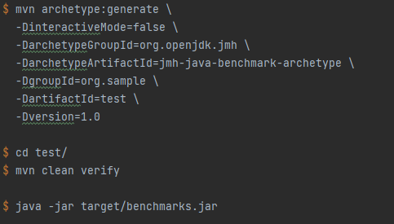
Getting Started
Maven preferred, but Gradle and Scala SBT plugins exists also

Slide 11
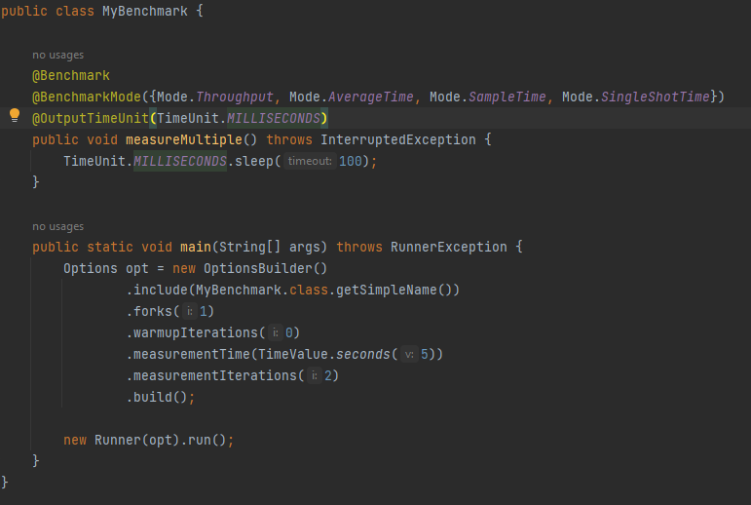
@BenchmarkMode

Slide 12
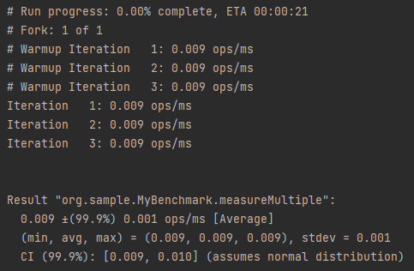
@BenchmarkMode

Slide 13
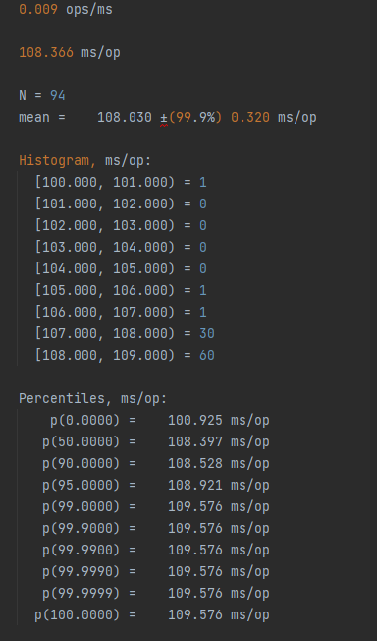
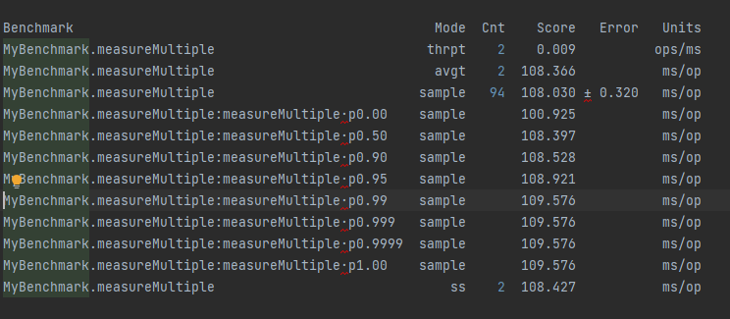
@BenchmarkMode

Slide 14
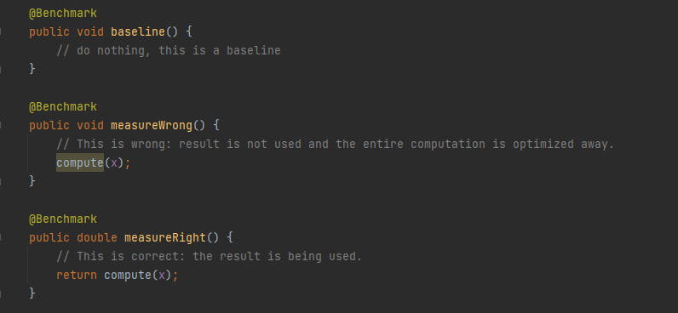
Dead Code Elimination

Slide 15
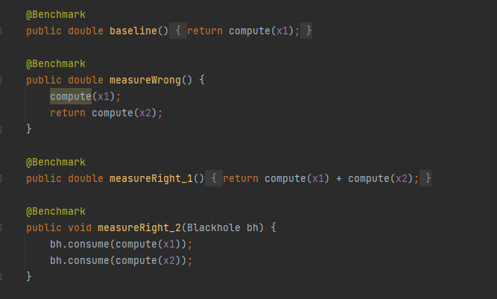
Dead Code Elimination

Slide 16
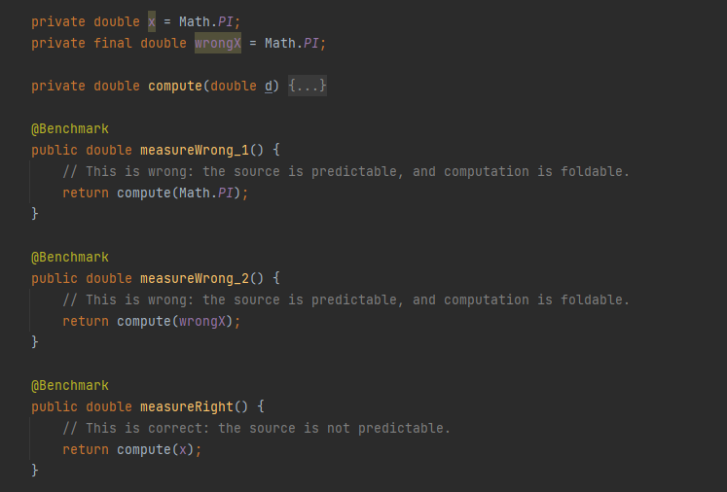
Constant Folding

Slide 17
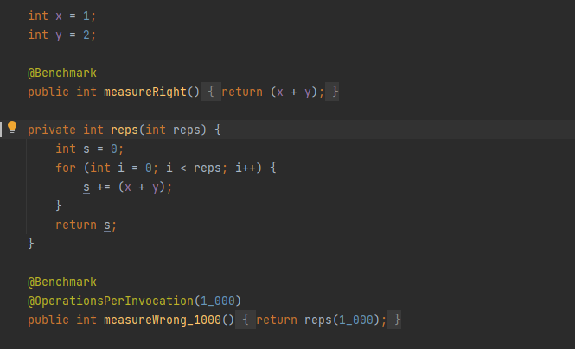
Loops

Slide 18
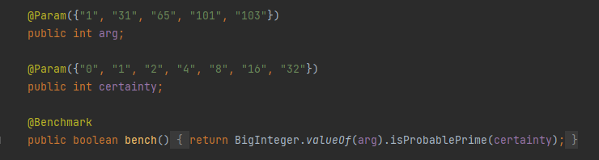
@Params

Slide 19
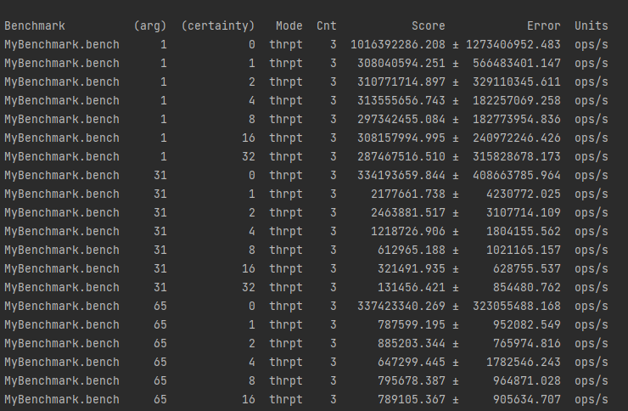
@Params

Slide 20
CUJO Story
30M agents online
Data stream >1M mps
Multiple services, >2k CPUs
Profiling shows a few places worth investigation

Slide 21
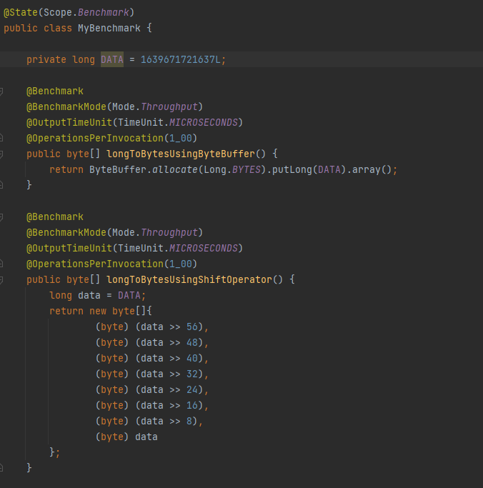
Long to Bytes Serialization

Slide 22
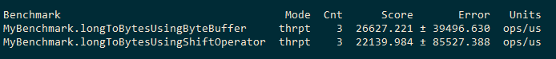
Java 11 vs 17

Slide 23
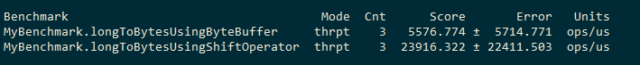
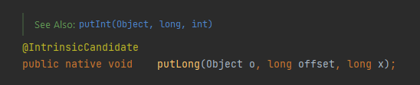
@IntrinsicCandidate

Slide 24
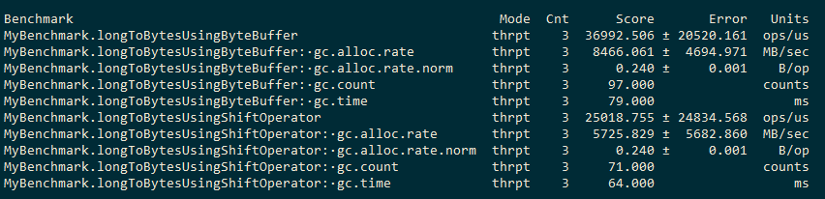
Memory Profiling (-prof gc)

Slide 25
Q & A

